Slide 1
Chapter V: Structured Knowledge Representation

Slide 2
Outline
Representations and Mappings
Approaches to Knowledge Representation
Issues in Knowledge Representation
Semantics Net
Frames
Conceptual Dependencies
Scripts

Slide 3
Knowledge
Data
Information
Knowledge
Recorded Knowledge
Knowledge Engineering

Slide 4
Representations and Mappings
Solving Complex Problems is guided by requirement of large amount of knowledge and some mechanisms to manipulate that knowledge and create the solution to the Problem
For that knowledge is to be represented for which the following points are to be considered
  Facts: that we want to represent, i.e. the truth in the representing world
  Representation: in some formal way

Slide 5
Representations and Mappings
For structuring these entities one way is to think at two levels:
  The knowledge level
  The symbol level
At knowledge level facts are described
At symbol level objects represented at knowledge level are defined in terms of symbols that can be manipulated by programs

Slide 6
Representations and Mappings (Reviewing)
Figure: Mapping Facts and Representation
*
Reasoning Agent
Facts
Internal Representation
*
Natural Language Generation
Natural Language Understanding
English Representation

Slide 7
Representations and Mappings
Rather than thinking of one level on top of another, focusing on facts, representations and on the two way mappings that must exist between them is more important
These links are called Representation Mappings
Forward Representation Mapping maps facts to representations
Backward Representation Mapping maps representations to facts

Slide 8
Representations and Mappings
Initial Facts
Desired Real Reasoning
Final Facts
Forward Representation Mapping
Backward Representation
Mapping
Figure: Representation Of Facts
Internal Representation Of Initial Facts
Internal Representation Of Final Facts
Operation of Program

Slide 9
Approaches to Knowledge Representation
For a good system following four properties are must
Representational Adequacy: Ability to represent all kind of knowledge that are needed in the domain
Inferential Adequacy: Ability to manipulate the representational structure in such a way as to derive new structures corresponding to new knowledge inferred from old
Inferential Efficiency: Ability to incorporate into the knowledge structure additional information that can be used to focus the attention of the inference mechanism in the most promising direction
Acquisitional Efficiency: Ability to acquire new information easily

Slide 10
Knowledge Representation: Types
Simple Relational Knowledge
  The simplest way to represent declarative facts is as a set of relations of the same sort used in database system
Inheritable Knowledge
  Structure must be designed to correspond to the inference mechanism that are desired
Inferential Knowledge
  Represents knowledge as formal logic
  Based on reasoning from facts or from other inferential knowledge
  Useless unless there is also an inference procedure that can exploit it
Procedural (Imperative) Knowledge
  Knowledge exercised in the performance of some task
  Processed by an intelligent agent

Slide 11
Issues in Knowledge Representation
Are any attributes of objects so basic that they have been occurred in almost every problem domain?
Are there any important relationships that exist among attributes of objects
At what level should knowledge be represented?
How should sets of objects be represented?
How can relevant parts be accessed when they are needed?

Slide 12
Semantic Networks
Semantic networks are alternative of predicate logic for knowledge representation.
In Semantic networks, we can represent our knowledge in the form of graphical networks.
This network consists of nodes representing objects and arcs which describe the relationship between those objects.
Semantic networks can categorize the object in different forms and can also link those objects.
Semantic networks are easy to understand and can be easily extended.

Slide 13
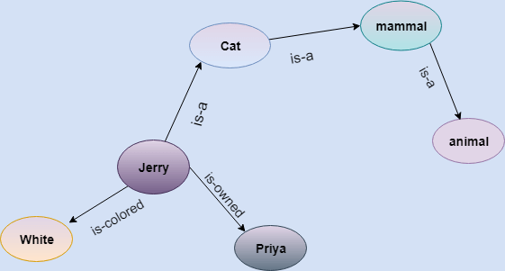
Semantic Networks
This representation consist of mainly two types of relations:
IS-A relation (Inheritance)
Kind-of-relation
Statements:
Jerry is a cat.
Jerry is a mammal
Jerry is owned by Priya.
Jerry is brown colored.
All Mammals are animal.

Slide 14






Semantic Networks
Mammal
Subset of
Has mother
Human
Subset of
Subset of
Female
Male
Member of
Member of
Husband of
Sima
Raju
Figure: Semantic Network Example

Slide 15
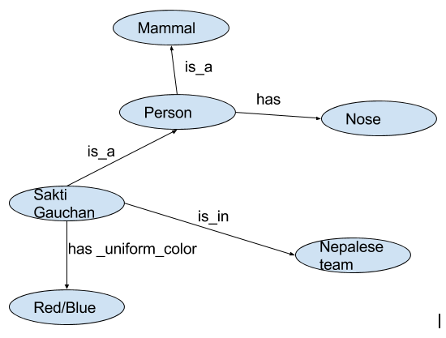
Example::
Q) Declarative knowledge base is:
- A person is a mammal
- Sakti Gauchan is a person
- Person has nose
- Sakti gauchan is in Nepalese team.
- Uniform color of sakti gauchan is Red/blue
Draw the semantic net representation.

Slide 16
Frames
A frame is a collection of attributes (slots) and associated values and possibly constraints on values that describe some entity in the world.
Frame system is build on a set of frames that are connected to each other by the virtue of fact that the value of an attribute of one frame may be another frame
Generally, Frames are based on set theory

Slide 17
Frames are derived from semantic networks and later evolved into our modern-day classes and objects.
A single frame is not much useful.
Frames system consist of a collection of frames which are connected.
In the frame, knowledge about an object or event can be stored together in the knowledge base.
The frame is a type of technology which is widely used in various applications including Natural language processing and machine visions.

Slide 18
Frames
Example:
Human Isa: Mammal
Cardinality: 6000000000
*Legs: 2 Male
Isa: Human Cardinality: 4000000000
*Hair: Short
Example: 2
Let's take an example of a frame for a book
Slots | Value
Title | Artificial Intelligence
Genre | Computer Science
Author | Peter Norvig
Edition | Third Edition
Year | 1996
Page | 1152

Slide 19
Conceptual Dependencies
Theory of how to represent the kind of knowledge about events that is usually contained in natural language sentences
Goal:
  Concluding inferences from the sentences
  Independent of the language in which the sentences were originally stated

Slide 20
Conceptual Dependencies
Use conceptual primitives that can be combined to form the meaning of the word in any particular language
Provides both a structure and a specific set of primitives for information construction

Slide 21
Conceptual Dependencies
Example: I gave the man a book
P o R to man
I ⬅➔ATRANS ←book ←
from I
Where, the symbols have following meaning
  Arrows indicates direction of dependency
  Double arrow indicates two way link between actor and action
  P indicates Past Tense, O indicates object case relation, R indicates reciepient case relation
  ATRANS indicates transfer of possession(Primitive)

Slide 22
Conceptual Dependencies: Primitive Acts
ATRANS: Transfer an abstract relationship, example: take
PTRANS: Transfer of physical location of an object, example: come
PROPEL: Application of physical force to an object, example: pull
MOVE: Movement of body part by its owner, example: punch
GRASP: Grasping of an object by an actor, example: clutch
INGEST: Ingestion of an object by an animal, example: eat
EXPEL: Expulsion of something from the body of an animal, example: spit
MTRANS: Transfer of Mental Information, example: tell
MBUILD: Building new information out of old, example: decide
SPEAK: Production of sounds, example: say
ATTEND: Focusing on sense organ toward a stimulus, example: Listen

Slide 23
Conceptual Dependencies: Set of tenses
p: Past
f: Future
t : Transition
t_{s}: Start Transition
t_{f}: Finish Transition
k: Continuing
?: Interrogative
/: Negative
nil: Present
Delta: Timeless
c: Conditional

Slide 24
Scripts
A script is a structure that is used to describe the sequence of events in a particular context
It consists of a set of slots
Each slot is associated with some information describing the kind of values a slot may contain as well as a default value to be used if no other information is available
Script seems to be similar to frames but these have more detailed information
For example: refer to Page Number 286, Artificial Intelligence, Rich and Knight.

